Slide 1
Design of Outreach portal for Virtual Labs
Wireframes

Slide 2
Design of Outreach portal for Virtual Labs
Primary Users
1
Nodal Coordinators
Key tasks:
Prepare for conducting V labs introduction workshop
Get material for conducting the V labs workshop
Reporting the information from conducted V Labs workshop
Track the workshop targets for the year
2
Outreach Coordinators
Key tasks:
Manage the outreach workshop Nodal coordinators
Track Nodal coordinators performance
Approve workshop reports
Manage training of new Nodal coordinators

Slide 3
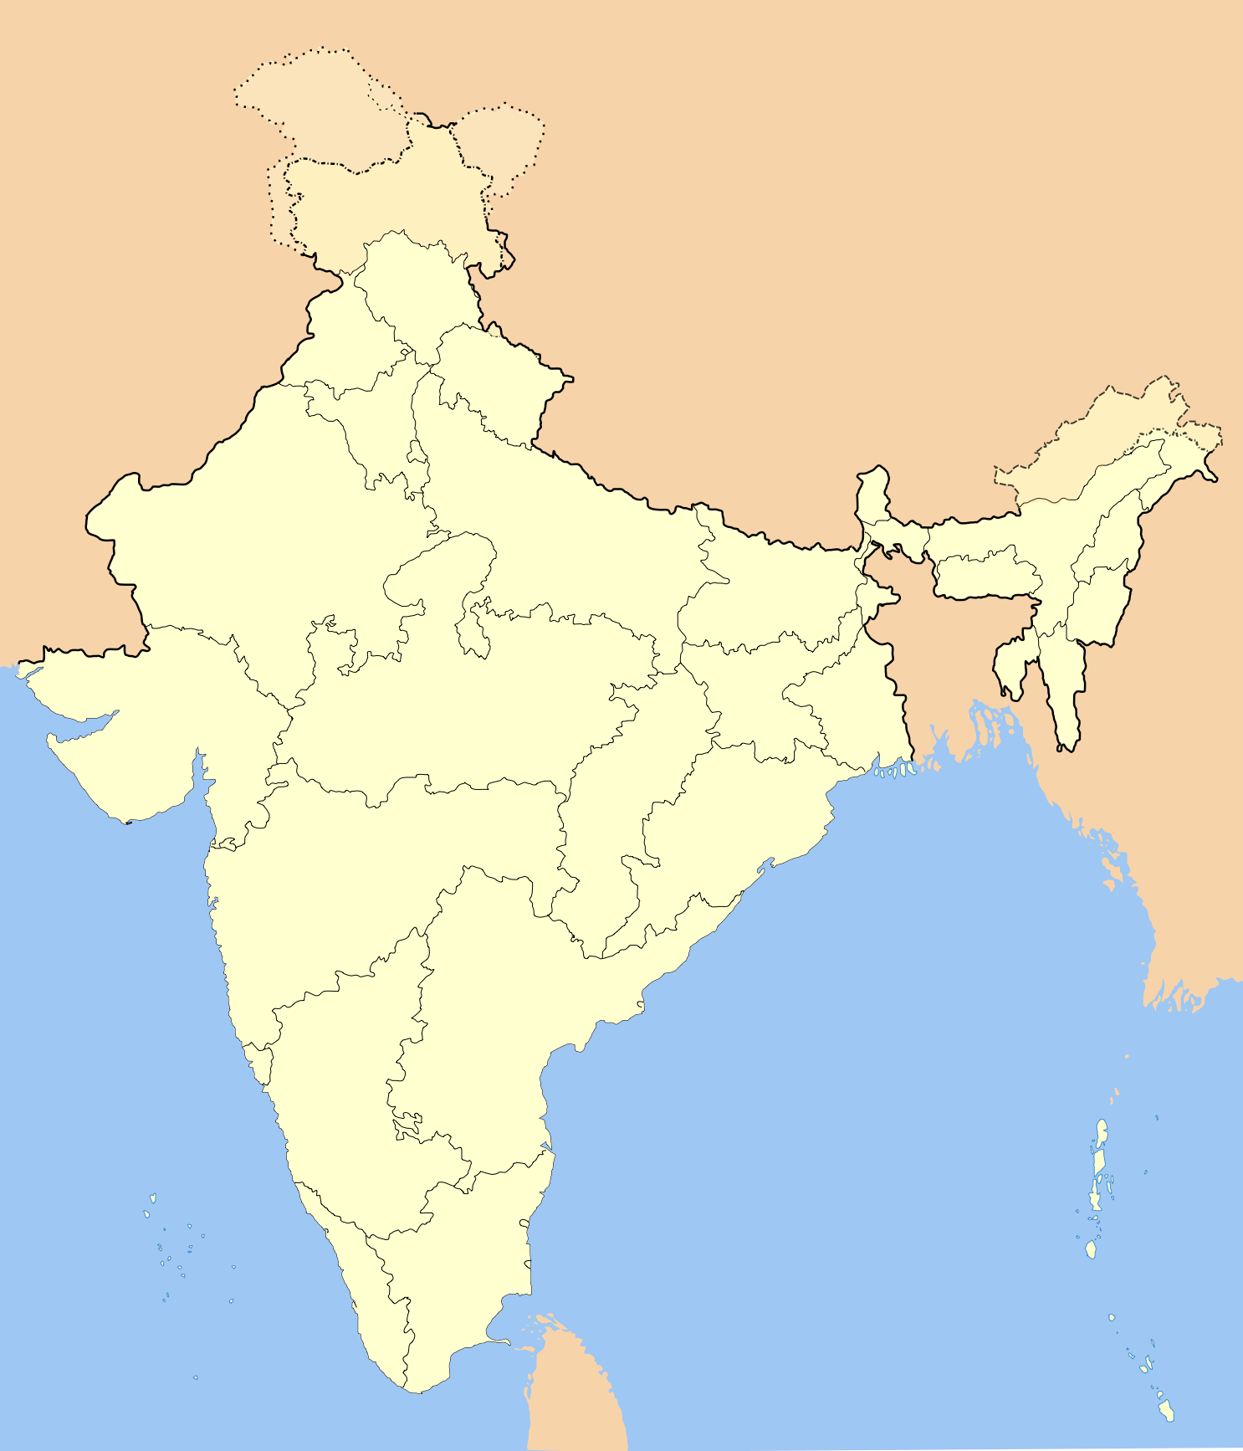
Outreach portal: Landing page – Option 1
For all users
Virtual Labs: Outreach Portal
An Initiative of Ministry of Human Resource Development (MHRD)
Under the National Mission on Education through ICT
WORKSHOPS RUN
LABS TAKEN
NODAL CENTERS
150+
7,500+
250+
Geographical reach of Virtual Labs
Portal Login
Email
Password
Login
Upcoming Workshops
JUL
1
GNIT, Warangal
Ramesh Reddy

Slide 4
Outreach portal: Landing page – Option 2
For all users
Virtual Labs: Outreach Portal
An Initiative of Ministry of Human Resource Development (MHRD)
Under the National Mission on Education through ICT
WORKSHOPS RUN
LABS TAKEN
NODAL CENTERS
150+
7,500+
250+
Recent workshop photos
Portal Login
Email
Password
Login
Upcoming Workshops
JUL
1
GNIT, Warangal
Ramesh Reddy
JUL
3
RIT, Aurangabad
Mohan Rao
JUL
4
COE Ludhiana
Kiran Kumar

Slide 5
Design of Outreach portal for Virtual Labs
User: Nodal Coordinator
Key tasks:
Prepare for conducting V labs introduction workshop
Get material for conducting the V labs workshop
Reporting the information from conducted V Labs workshop
Track the workshop targets for the year

Slide 6

Outreach portal: After login – first time
For Nodal Coordinator
Virtual Labs
Ramesh Reddy
GNIT, Warangal
Outreach Portal
Welcome to Virtual Labs Outreach Portal
You are added to Virtual Labs Outreach portal to help you conduct workshops and report them.
Your Login Details
Login Id
ramesh.reddy@gnitw.edu
Enter Password
Password should be 6-12 characters
Profile Photo
Upload your photo
Your Outreach Target: For 1 Jul 2015 to 20 Jun 2016
Workshops to conduct
6
Participants to cover
1200
Experiments to conduct
3600
Login

Slide 7
Outreach portal: Guides & Material Show this page first time after password is created
For Nodal Coordinator
Virtual Labs
Ramesh Reddy
GNIT, Warangal
Outreach Portal
WORKSHOPS RUN
PARTICIPANTS
EXPERIMENTS
0/6
0/1200
0/3600
Guides & Material
Active Workshops
New Workshop
History
Guides
Planning a workshop
Conducting a workshop
Workshop Material
For Print
Download all
PDF
Attendance sheet
PDF
Feedback form
PDF
Flyers
PDF
Banners
Presentation & Reporting
Download all
PPT
Virtual Labs Introduction presentation
DOC
College Report format

Slide 8
Outreach portal: New Workshop
For Nodal Coordinator
Virtual Labs
Ramesh Reddy
GNIT, Warangal
Outreach Portal
WORKSHOPS RUN
PARTICIPANTS
EXPERIMENTS
0/6
0/1200
0/3600
Guides & Material
Active Workshops
New Workshop
History
Plan a New Workshop
Check eligibility
Name
Check agenda guide
Workshop Material
Location
For Print
Participating institutes
Attendance sheet
Feedback form
Date
Flyers
Banners
Number of participants
Templates
Agenda for workshop
College report
Workshop presentation
Number of sessions
Download
Duration of sessions

Slide 9
Outreach portal: New Workshop – 2nd page after scrolling down
For Nodal Coordinator
Agenda for workshop
Number of sessions
Subject of sessions
Labs planned
Other details
Like special guest attending,
Submit
Save
Cancel

Slide 10
Outreach portal: Active Workshop Once a new workshop is created its shown in Active workshops
For Nodal Coordinator
Virtual Labs
Ramesh Reddy
GNIT, Warangal
Outreach Portal
WORKSHOPS RUN
PARTICIPANTS
EXPERIMENTS
0/6
0/1200
0/3600
Guides & Material
Active Workshops
New Workshop
History
JUL
1
GNIT, Warangal
200 participants
3 sessions
1.5 hour/session
Edit
Participating institutes: BVRIT Warangal,
Computer science & engineering
Data Structures
Submit Report

Slide 11
Outreach portal: Active Workshop Once workshop is conducted Submit Report is used to file the report
For Nodal Coordinator
Virtual Labs
Ramesh Reddy
GNIT, Warangal
Outreach Portal
WORKSHOPS RUN
PARTICIPANTS
EXPERIMENTS
0/6
0/1200
0/3600
Guides & Material
Active Workshops
New Workshop
History
JUL
1
GNIT, Warangal
200 participants
3 sessions
1.5 hour/session
Edit
Participating institutes: BVRIT Warangal,
Computer science & engineering
Data Structures
Submit Report
From the workshops conducted report the following information
Number of participants attended:
Number of experiments conducted:
Upload documents
Attendance sheet
Upload
College report
Upload
Workshop photos
Upload
Comments & Feedback

Slide 12
Outreach portal: Active Workshop Once workshop is conducted Submit Report is used to file the report – scroll down
For Nodal Coordinator
Workshop photos
Upload
Comments and Feedback
Positive
Based on your experience in planning & conducting the workshop
From the faculty and students of the participating institutes
Negative
Submit for Approval
Save
Cancel

Slide 13

Outreach portal: Active Workshop Report submitted but Pending approval
For Nodal Coordinator
Virtual Labs
Ramesh Reddy
GNIT, Warangal
Outreach Portal
WORKSHOPS RUN
PARTICIPANTS
EXPERIMENTS
0/6
0/1200
0/3600
Guides & Material
Active Workshops
New Workshop
History
JUL
1
GNIT, Warangal
214 participants
578 experiments
Pending Approval
Edit
Attendance sheet
College report
Workshop photos
View Report

Slide 14
Outreach portal: History Once report is approved its moved to History. Analytics get updated.
For Nodal Coordinator
Virtual Labs
Ramesh Reddy
GNIT, Warangal
Outreach Portal
WORKSHOPS RUN
PARTICIPANTS
EXPERIMENTS
1/6
214/1200
578/3600
Guides & Material
Active Workshops
New Workshop
History
JUL
1
GNIT, Warangal
214 participants
578 experiments
View Report

Slide 15
Outreach portal: History View Report
For Nodal Coordinator
Virtual Labs
Ramesh Reddy
GNIT, Warangal
Outreach Portal
WORKSHOPS RUN
PARTICIPANTS
EXPERIMENTS
1/6
214/1200
578/3600
Guides & Material
Active Workshops
New Workshop
History
JUL
1
GNIT, Warangal
214 participants
578 experiments
View Report
Attendance sheets
College report
Workshop Photos

Slide 16
Outreach portal: History View Report
For Nodal Coordinator
Virtual Labs
Ramesh Reddy
GNIT, Warangal
Outreach Portal
WORKSHOPS RUN
PARTICIPANTS
EXPERIMENTS
1/6
214/1200
578/3600
Guides & Material
Active Workshops
New Workshop
History
JUL
1
GNIT, Warangal
214 participants
578 experiments
View Report
Attendance sheets
College report
Workshop Photos
1 of 7 photos

Slide 17
Design of Outreach portal for Virtual Labs
User: Outreach Coordinator
Key tasks:
Manage the outreach workshop Nodal coordinators
Track Nodal coordinators performance
Approve workshop reports
Manage training of new Nodal coordinators

Slide 18
Outreach portal: Upcoming Workshops
For Outreach Coordinator
Virtual Labs
Geeta Bose
IIIT, Hyderabad
Outreach Portal
Manage Nodal Centers
EXPERIMENTS
PARTICIPANTS
WORKSHOPS
NODAL CENTERS
0/90K
0/30K
0/150
6/25
Upcoming Workshops
Pending for Approval
Workshop History
Nodal Coordinator Training
Date
Location
Participants planned
Participating Institutes
Nodal Coordinator
1 Jul
Wed
GNIT, Warangal
200
BVRIT, Warangal
Sri Krishna College of …
Ramesh Reddy
3 Jul
Fri
KREC, Nizamabad
250
SNRJ, Nizamabad
VITS, Nizamabad
Vijay Kumar
4 Jul
Sat
AURK, Uppal
300
CBIT, Gandipet
SREC, Nizamabad
Vijay Kumar
4 Jul
Sat
KREC, Nizamabad
300
SNRJ, Nizamabad
VITS, Nizamabad
Vijay Kumar

Slide 19
Outreach portal: Upcoming Workshops
For Outreach Coordinator
Virtual Labs
Geeta Bose
IIIT, Hyderabad
Outreach Portal
Manage Nodal Centers
EXPERIMENTS
PARTICIPANTS
WORKSHOPS
NODAL CENTERS
0/90K
0/30K
0/150
6/25
Upcoming Workshops
Pending for Approval
Workshop History
Nodal Coordinator Training
Date
Location
Participants
Experiments
Participating Institutes
Nodal Coordinator
27 Jun
Sat
GNIT, Warangal
214
578
BVRIT, Warangal
Sri Krishna College of …
Ramesh Reddy
View Report
24 Jun
Wed
KREC, Nizamabad
343
985
SNRJ, Nizamabad
VITS, Nizamabad
KITS, Nizamabad
Vijay Kumar
View Report
AURK, Uppal
300
811
CBIT, Gandipet
SREC, Nizamabad
View Report
22 Jun
Mon
Vijay Kumar

Slide 20
Outreach portal: Pending Workshops
For Outreach Coordinator
Virtual Labs
Geeta Bose
IIIT, Hyderabad
Outreach Portal
Manage Nodal Centers
EXPERIMENTS
PARTICIPANTS
WORKSHOPS
NODAL CENTERS
0/90K
0/30K
0/150
6/25
Upcoming Workshops
Pending for Approval
Workshop History
Nodal Coordinator Training
Date
Location
Participants
Experiments
Participating Institutes
Nodal Coordinator
27 Jun
Sat
GNIT, Warangal
214
578
BVRIT, Warangal
Sri Krishna College of …
Ramesh Reddy
View Report
Attendance sheets
College report
Workshop Photos

Slide 21
Outreach portal: Pending Workshops
For Outreach Coordinator
27 Jun
Sat
GNIT, Warangal
214
578
BVRIT, Warangal
Sri Krishna College of …
Ramesh Reddy
View Report
Attendance sheets
College report
Workshop Photos
Comments
1 of 5 sheets

Slide 22
Outreach portal: Pending Workshops
For Outreach Coordinator
27 Jun
Sat
GNIT, Warangal
214
578
BVRIT, Warangal
Sri Krishna College of …
Ramesh Reddy
View Report
Attendance sheets
College report
Workshop Photos
Comments
5 of 5 sheets
Checklist for approval
Yes
No
Total attendance matches the reported participants
Reject
Next

Slide 23
Outreach portal: Pending Workshops
For Outreach Coordinator
27 Jun
Sat
GNIT, Warangal
214
578
BVRIT, Warangal
Sri Krishna College of …
Ramesh Reddy
View Report
Attendance sheets
College report
Workshop Photos
Comments
Checklist for approval
Yes
No
Report is on the college letterhead
Report is signed by the college principal
Report has the college seal stamped
Reject
Next

Slide 24
Outreach portal: Pending Workshops
For Outreach Coordinator
27 Jun
Sat
GNIT, Warangal
214
578
BVRIT, Warangal
Sri Krishna College of …
Ramesh Reddy
View Report
Attendance sheets
College report
Workshop Photos
Comments
1 of 7 photos
Next
Reject

Slide 25
Outreach portal: Pending Workshops
For Outreach Coordinator
27 Jun
Sat
GNIT, Warangal
214
578
BVRIT, Warangal
Sri Krishna College of …
Ramesh Reddy
View Report
Attendance sheets
College report
Workshop Photos
Comments
7 of 7 photos
Next
Reject

Slide 26
Outreach portal: Pending Workshops If report is compliance is ‘Yes’ then the ‘Approve Report’ is shown
For Outreach Coordinator
27 Jun
Sat
GNIT, Warangal
214
578
BVRIT, Warangal
Sri Krishna College of …
Ramesh Reddy
View Report
Attendance sheets
Positive comments
Great comments
Positive
Positive
Positive
College report
Workshop Photos
Comments
Negative comments
No so good comments
poor
bad
Approve Report
Reject

Slide 27
Outreach portal: Pending Workshops If report is compliance is ‘No’ then the ‘Approve Report’ is shown
For Outreach Coordinator
27 Jun
Sat
GNIT, Warangal
214
578
BVRIT, Warangal
Sri Krishna College of …
Ramesh Reddy
View Report
Attendance sheets
Positive comments
Great comments
Positive
Positive
Positive
College report
Workshop Photos
Comments
Negative comments
No so good comments
poor
bad
Reject
Submit

Slide 28
Outreach portal: Workshop History If workshop report is Approved – then the workshop moves under History
For Outreach Coordinator
Virtual Labs
Geeta Bose
IIIT, Hyderabad
Outreach Portal
Manage Nodal Centers
EXPERIMENTS
PARTICIPANTS
WORKSHOPS
NODAL CENTERS
578/90K
214/30K
1/150
6/25
Upcoming Workshops
Pending for Approval
Workshop History
Nodal Coordinator Training
Date
Location
Participants
Experiments
Participating Institutes
Nodal Coordinator
27 Jun
Sat
GNIT, Warangal
214
578
BVRIT, Warangal
Sri Krishna College of …
Ramesh Reddy
View Report

Slide 29

Outreach portal: Workshop History If workshop report is Approved – then the workshop moves under History
For Outreach Coordinator
Virtual Labs
Geeta Bose
IIIT, Hyderabad
Outreach Portal
Manage Nodal Centers
EXPERIMENTS
PARTICIPANTS
WORKSHOPS
NODAL CENTERS
578/90K
214/30K
1/150
6/25
Upcoming Workshops
Pending for Approval
Workshop History
Nodal Coordinator Training
Date
Location
Participants
Experiments
Participating Institutes
Nodal Coordinator
27 Jun
Sat
GNIT, Warangal
214
578
BVRIT, Warangal
Sri Krishna College of …
Ramesh Reddy
View Report

Slide 30

Outreach portal: Workshop History If workshop report is Approved – then the workshop moves under History
For Outreach Coordinator
Virtual Labs
Geeta Bose
IIIT, Hyderabad
Outreach Portal
Manage Nodal Centers
EXPERIMENTS
PARTICIPANTS
WORKSHOPS
NODAL CENTERS
2.32K/90K
1.14K/30K
5/150
9/25
Upcoming Workshops
Pending for Approval
Workshop History
Nodal Coordinator Training
Nodal coordinators performance
6
5
4
3
2
1
Ravi
Jairam
Vijay M
Ganesh
Ravi
Jairam
Vijay M
Ganesh
Dinesh
Nodal coordinators
Date
Location
Participants
Experiments
Participating Institutes
Nodal Coordinator
27 Jun
Sat
GNIT, Warangal
214
578
BVRIT, Warangal
Sri Krishna College of …
Ramesh Reddy
View Report

Slide 31
Outreach portal: Nodal coordinators training
For Outreach Coordinator
Virtual Labs
Geeta Bose
IIIT, Hyderabad
Outreach Portal
Manage Nodal Centers
EXPERIMENTS
PARTICIPANTS
WORKSHOPS
NODAL CENTERS
2.32K/90K
1.14K/30K
5/150
9/25
Upcoming Workshops
Pending for Approval
Workshop History
Nodal Coordinator Training

Slide 32
Outreach portal: Manage Nodal Center
For Outreach Coordinator
Virtual Labs
Geeta Bose
IIIT, Hyderabad
Outreach Portal
Manage Nodal Centers
EXPERIMENTS
PARTICIPANTS
WORKSHOPS
NODAL CENTERS
2.32K/90K
1.14K/30K
5/150
9/25
Manage Nodal Centers
+
New Nodal Center
Targets
Nodal Coordinator
Nodal Center
Email id
Date registered
Workshops
Participants
Experiments
1
Ramesh Reddy
GNIT, Warangal
ramesh.reddy@gnit.edu
14-Jun-2015
6
1200
3600
Edit
2
Vijay Kumar
KREC, Nizamabad
vijayk@krec.edu
14-Jun-2015
6
1200
3600
Edit
3
Ganesh M
AURK, Uppal
ganesh.m@aurk.edu
14-Jun-2015
6
1200
3600
Edit
4
Ravi Krishna
KREC, Nizamabad
ramesh.reddy@gmail.com
14-Jun-2015
6
1200
3600
Edit
5
Dinesh Sharma
JNIT, Ibrahimpatnam
dineshs@jnit.edu
14-Jun-2015
6
1200
3600
Edit

Slide 33
Outreach portal: Add New nodal center
For Outreach Coordinator
Virtual Labs
Geeta Bose
IIIT, Hyderabad
Outreach Portal
Manage Nodal Centers
EXPERIMENTS
PARTICIPANTS
WORKSHOPS
NODAL CENTERS
2.32K/90K
1.14K/30K
5/150
9/25
Add new Nodal Center
Name of center
Name of Coordinator
Email Id
Upload MOU
Upload
Targets of Nodal Coordinator
No of Workshops
No of Participants
No of experiments
Reject
Cancel
Add Nodal Center

